Slide 1
Comparative Analysis Amazon & Ebay Search engines

Slide 2

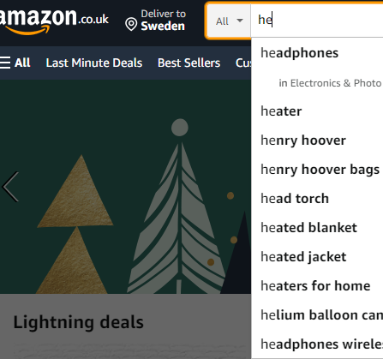
Amazon
Search engine
Big search box.
Search box appear in every page.
There is a dropline list when search, even with 2 letters are given alternatives.
Different auto-suggestions are given when search.

Slide 3
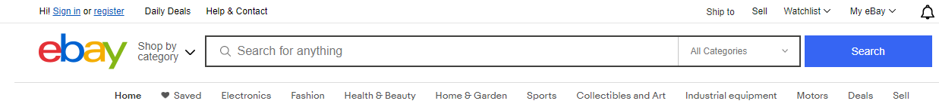
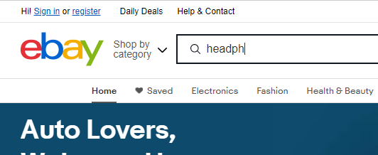
Ebay
Search engine
Big search box.
Search button available.
No droplist when writing on seacrh bar.
No auto-suggestions when writing on search bar for other words.

Slide 4
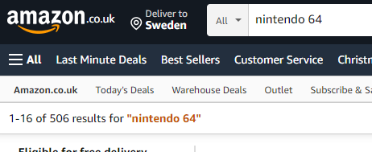
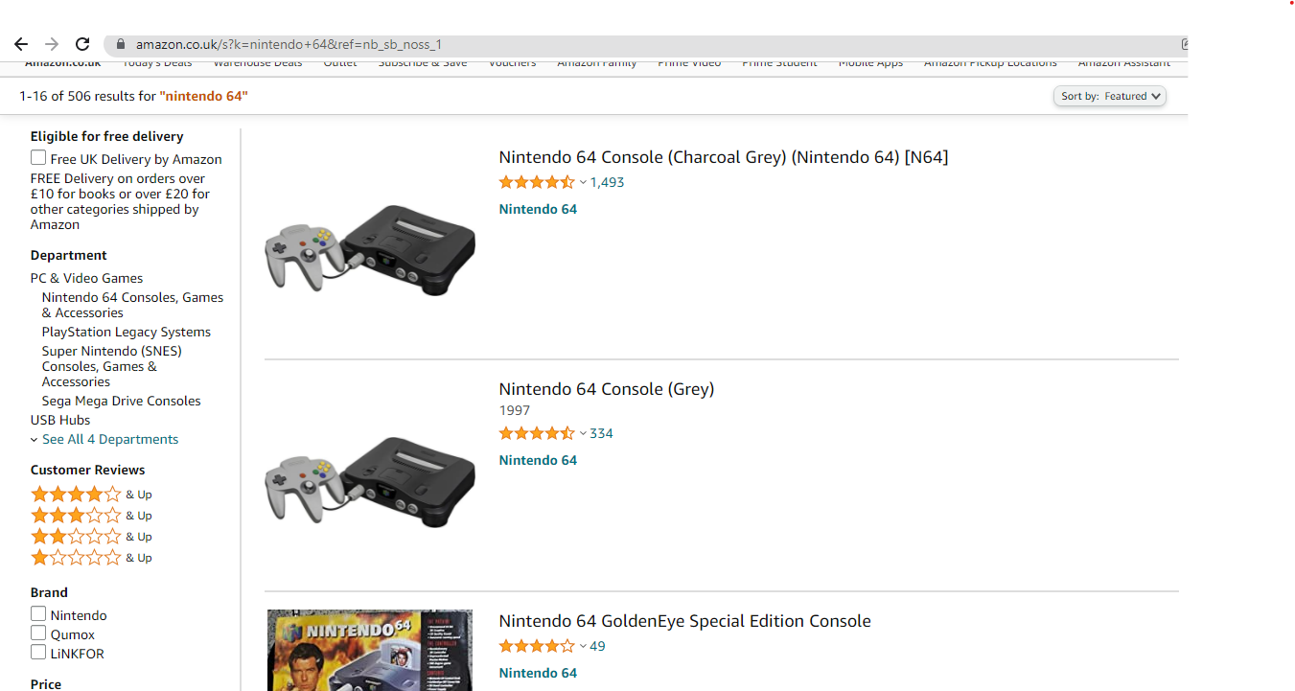
Amazon
Search results
Less items per search result page on Amazon than on Ebay.
It is displayed matching results.
No ads on product page.
Grid view on search results, a lot of white space around the product.

Slide 5
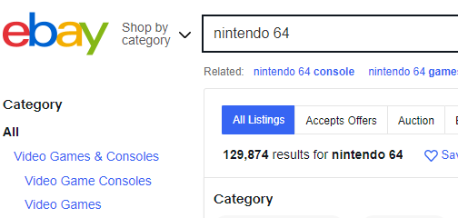
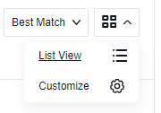
Ebay
Search results
More items per search result page on Ebay than Amazon.
It is displayed number of matching results.
Ads on the product page.
Allows list view or grid view on search results.

Slide 6
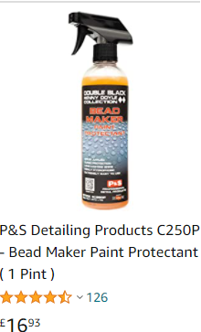
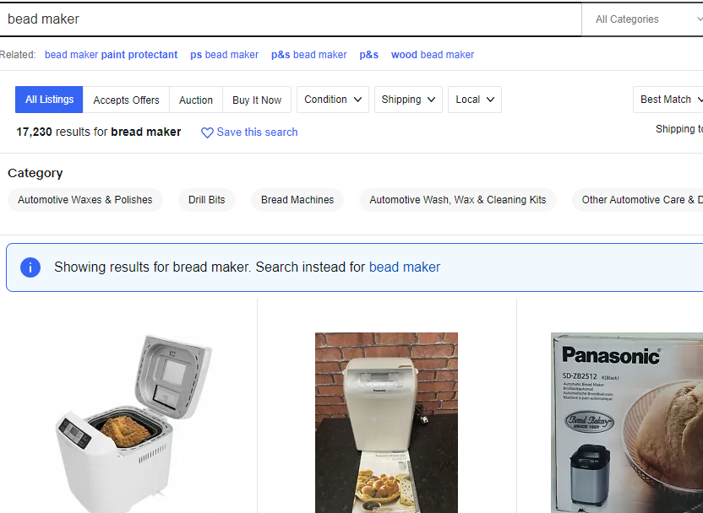
Searching Bead Maker (car painting product) on Amazon and Ebay
Amazon
Ebay
Amazon finds correct product Ebay thinks it was a spelling mistake (bread maker)

Slide 7
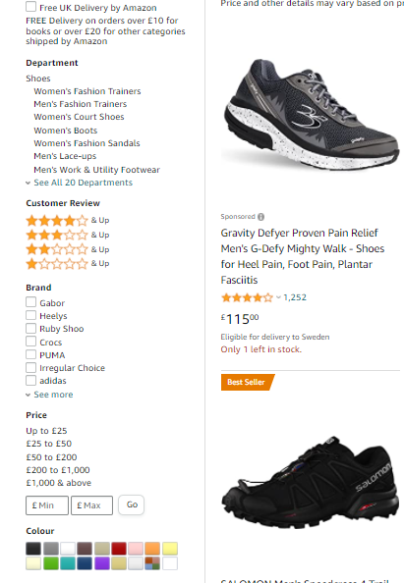
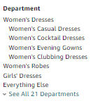

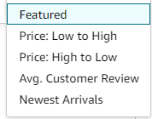
Amazon
Filtering and sorting
Allows shoppers to filter by cutomer rating.
Thematic filters.
Sort options for items are available.
Category specific filters are available.
Amazon personalize filtering experience by using shopper browser history.
Amazon hides parent level hyperlinks when link is selected. .
Recomendation products after filter results.
Checkbox filters available.

Slide 8
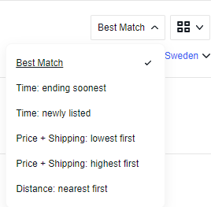
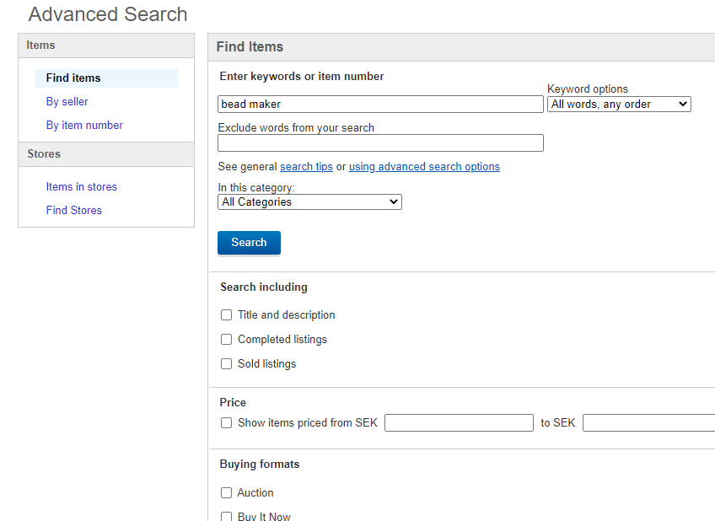
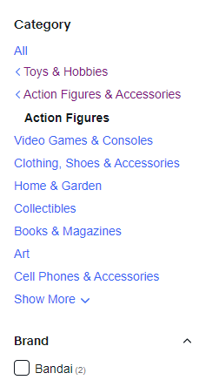
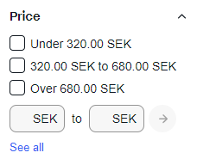
Ebay
Filtering and sorting
Sort options for items are available.
All category links are visible no mater if link selected or no.
Custom filters, example for price.
Advanced search filters.

Slide 9
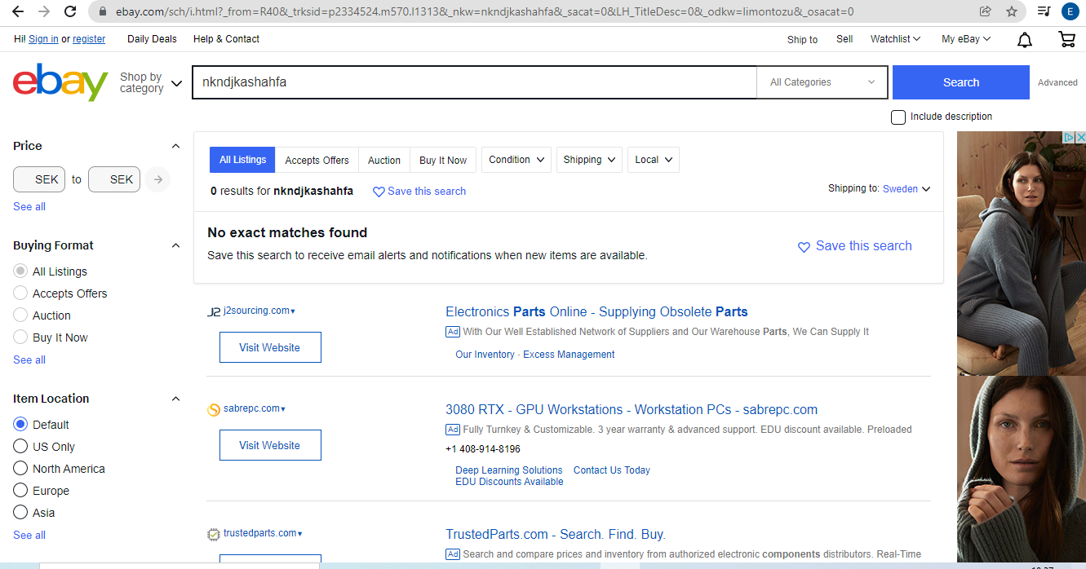
Ebay
Zero page results
No results found, links for different web sites available bellow.

Slide 10
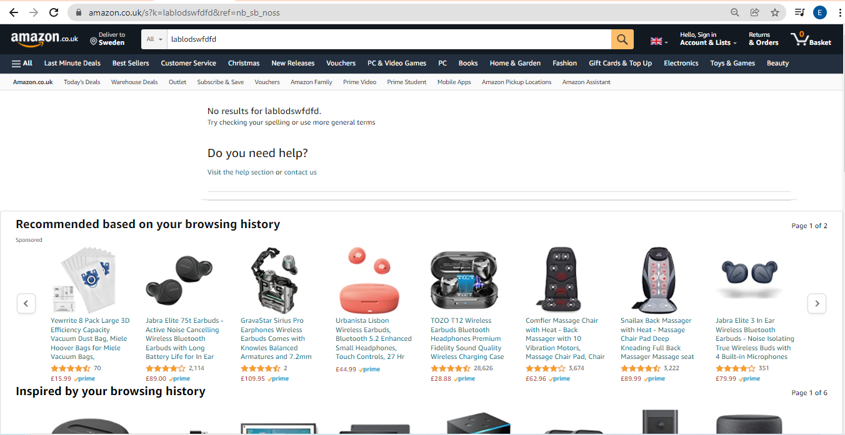
Amazon
Zero page results
No results found, other product recomendations available bellow.

